Slide 1
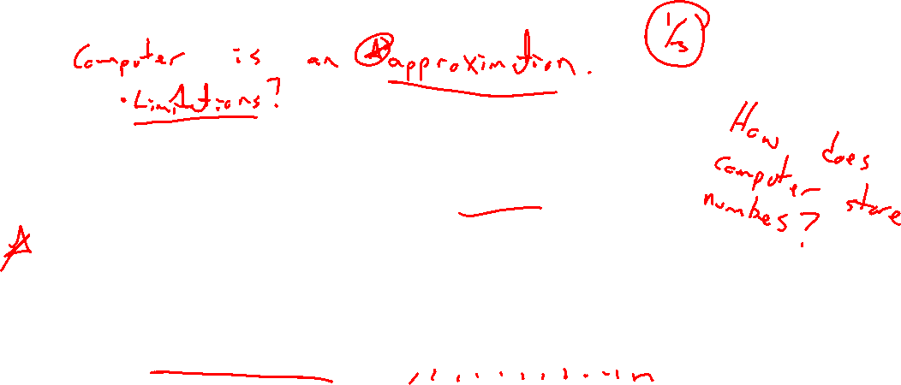
Section 1.3 Floating Point Representation
Lecture 1
Number systems and finite precision machines

Slide 2

Homework Submission to Canvas
Preview of section
Skim the section in text and write a short paragraph summary.
Give a bulleted list of all important definitions, theorems, and formulas without details.
Notes on video lectures
Take notes on everything written on slides including all details, worked examples, on-own activities, as well as your own thoughts and questions.
Try on-own activities first, then write down provided solution next to it for comparison.
Worked examples from the text
Write down the problem and attempt without looking at the solution.
Use the solution to write the best explanation you can.
Solutions to textbook exercises
Model approaches and explanations given in the video lectures and textbook examples.
Final reflection of section
List the key takeaways to remember as a bulleted list.

Slide 3
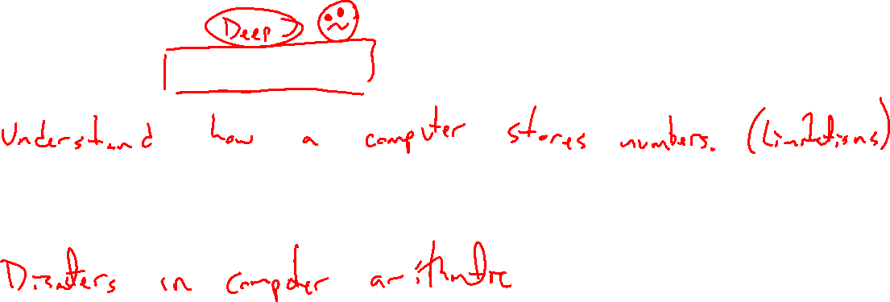
Goal and disclaimer
Notes:
Aim to understand computer number storage / arithmetic
Goal is to identify limitations of this (finite) system
Disasters in computer arithmetic

Slide 4
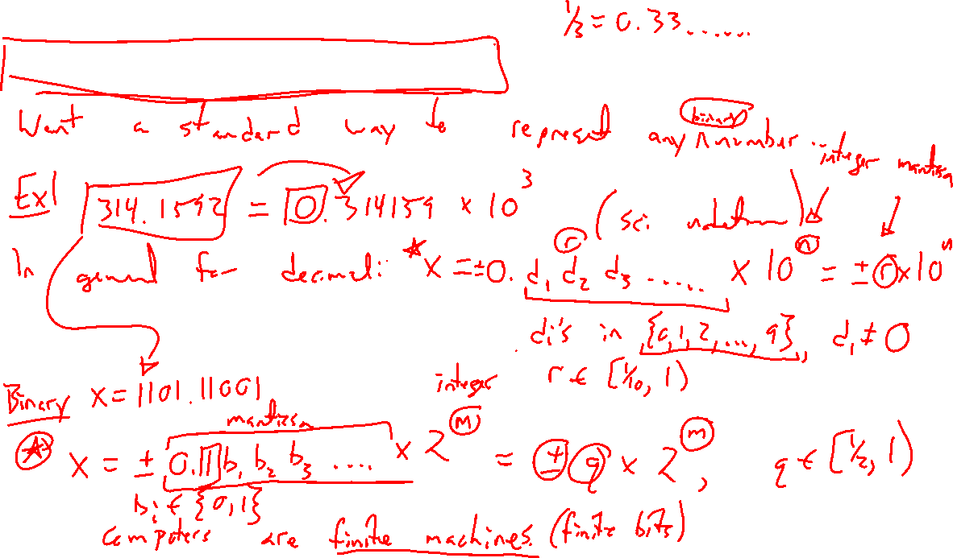
Normalized floating point representation
Notes:
Decimal in normalized floating point representation
123.4567 = 0.1234567 x 10^{-3}
In general, +- 0.d_1 d_2 … x 10^n = +- r x 10^n
Digits d_I in {0,1,…,9}, n integer, r in [1/10, 1) the mantissa, n the exponent.
Binary version as well. +- 0.1b_1 b_2 … x 2^m = +- q = 2^m (note first nonzero nmber has to be a 1)

Slide 5
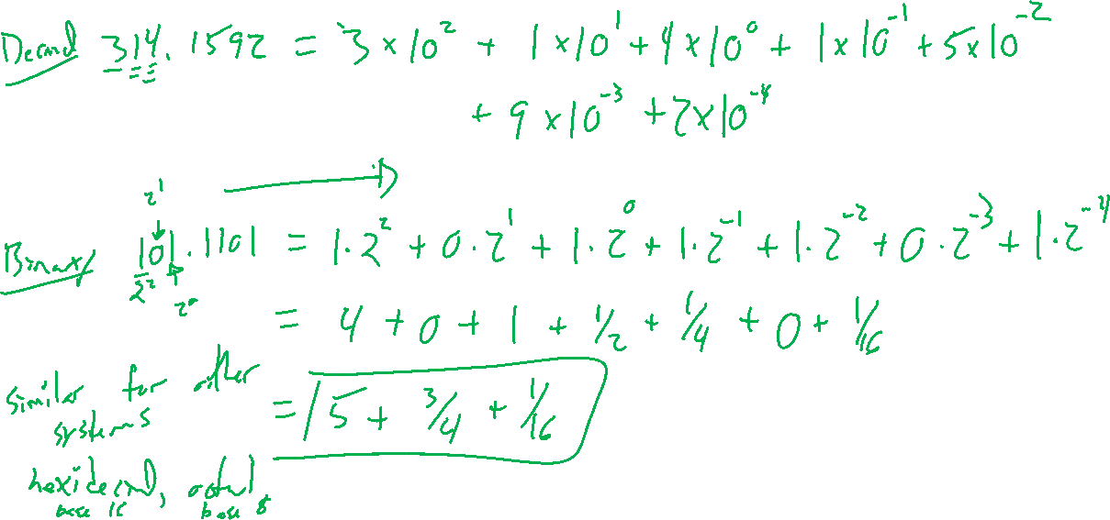
Number systems review
Notes:
Decimal: 314.1592 = 3x10^3 + ….
Binary: 110.1011 = ….
Other bases exist (octal, hexidecimal)

Slide 6
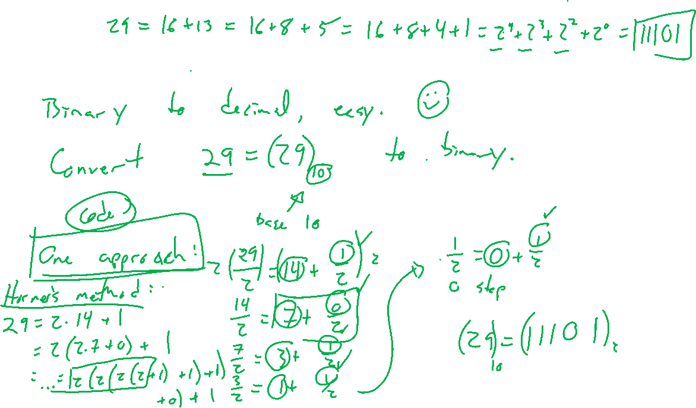
Example: Converting bases
Notes:
29 to binary, keep dividing by 2. (=11101_2)
Try on own: Convert 797 to base 5. Check result.

Slide 7
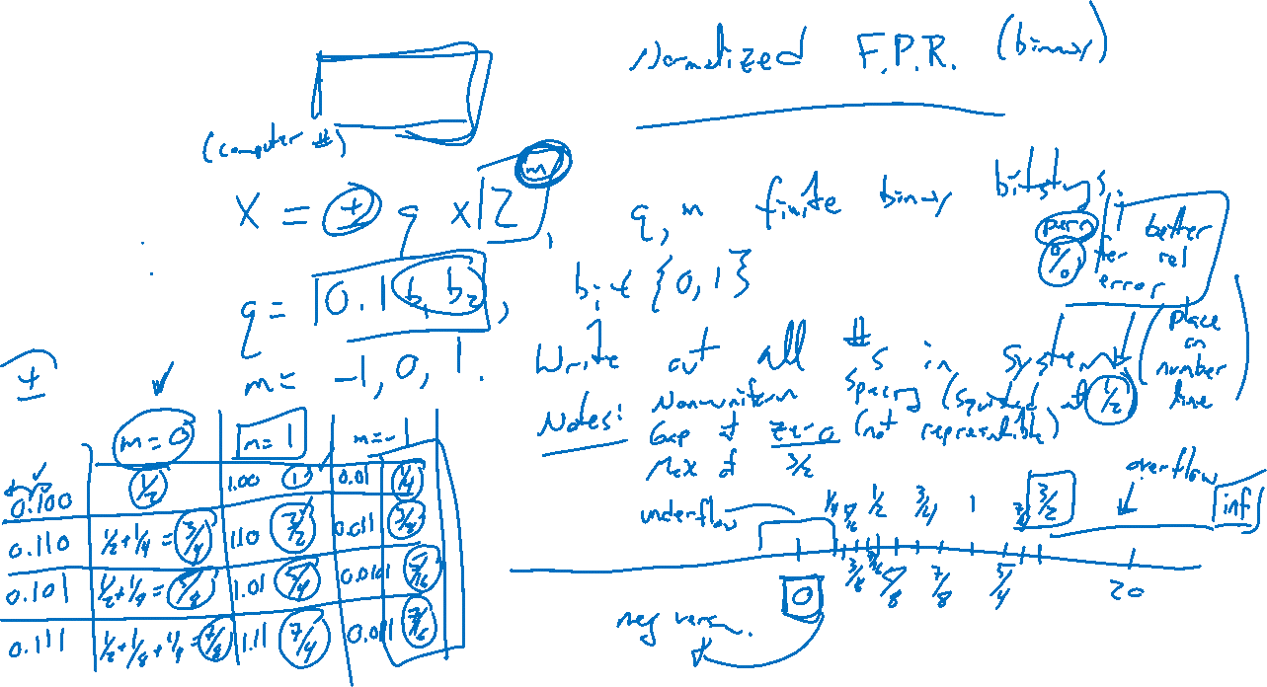
Example: Toying with computer numbers
Notes:
How does a computer store the number x = +- q \times 2^m, for m and q finite numbers in binary rep?
Let q = 0.1b_1 b_2, n=-1,0,1
Write out all numbers, place on a number line.
Note gaps, nonuniform, gap at zero
Largest number, overflow rounded to inf
Machine epsilon gives upper bound on relative error rounding. Smallest number such that 1+\eps \neq 1

